Slide 1
Debugging

Slide 2
Tools and techniques for finding the root cause of bugs in the program to fix bugs faster and with less effort.
To paraphrase an old joke among programmers, “Writing code accounts for 90 percent of programming. Debugging code accounts for the other 90 percent.”

Slide 3
There are a few tools and techniques to identify what exactly code is doing and where it’s going wrong.
First, consider logging and assertions - two features that can help detect bugs early.
The earlier the bugs are identified, the easier to fix.
Second, to use the debugger - a feature of IDLE that executes a program one instruction at a time, giving a chance to inspect the values in variables while the code runs, and track how the values change over the course of the program.
This is much slower than running the program at full speed, but it is helpful to see the actual values in a program while it runs, rather than deducing what the values might be from the source code

Slide 4
Raising Exceptions
Raising an exception is a way of saying, “Stop running the code in this function and move the program execution to the except statement.”
Exceptions are raised with a raise statement:
raise Exception('This is the error message.')
A raise statement consists of the following:
The raise keyword
A call to the Exception() function
A string with a error message passed to the Exception() function

Slide 5
The code that calls the function, knows how to handle an exception.
A raise statement is used inside a function and the try and except statements are used in the code calling the function.
def boxprint(symbol, width, height): if len(symbol) != 1: raise Exception('Symbol must be one character.') if width <= 2: raise Exception('Width must be > 2.') if height <= 2: raise Exception('Height must be > 2.') print(symbol * width) for i in range(height - 2): print(symbol + (' ' * (width - 2)) + symbol) print(symbol * width) for sym, w, h in (('*', 4, 4), ('O', 20, 5), ('x', 1, 3), ('ZZ', 3, 3)): try: boxprint(sym, w, h) except Exception as err: print('An exception happened: ' + str(err))
****
* *
* *
****
OOOOOOOOOOOOOOOOOOOO
O O
O O
O O
OOOOOOOOOOOOOOOOOOOO
An exception happened: Width must be > 2.
An exception happened: Symbol must be one character.

Slide 6
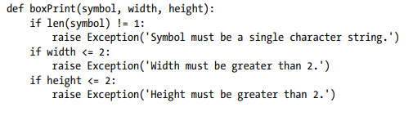
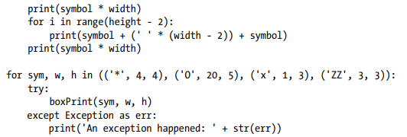

Slide 7
def boxprint(symbol, width, height): if len(symbol) != 1: raise Exception('Symbol must be one character.') if width <= 2: raise Exception('Width must be > 2.') if height <= 2: raise Exception('Height must be > 2.') print(symbol * width) for i in range(height - 2): print(symbol + (' ' * (width - 2)) + symbol) print(symbol * width) for sym, w, h in (('*', 4, 4), ('O', 20, 5), ('x', 1, 3), ('ZZ', 3, 3)): try: boxprint(sym, w, h) except Exception as err: print('An exception happened: ' + str(err))
This program uses the except Exception as err form of the except statement.
If an Exception object is returned from boxPrint(), this except statement will store it in a variable named err.
The Exception object can then be converted to a string by passing it to str() to produce a user-friendly error message

Slide 8
Assertions
An assertion is a sanity check to make sure the code is not doing something wrong.
These sanity checks are performed by assert statements.
If the sanity check fails, then an AssertionError exception is raised.
In code, an assert statement consists of the following:
The assert keyword
A condition (that is, an expression that evaluates to True or False)
A comma
A string to display when the condition is False

Slide 9
a = 4 b = 0 # using assert to check for 0 print("The value of a / b is : ") assert b != 0, "Zero Division Error" print(a / b)
a = "hello" b = 42 assert type(a) == str assert type(b) == int print("a =", a) print("b =", b)
a = hello
b = 42
The value of a / b is :
Traceback (most recent call last):
File "C:\Users\Lenovo\PycharmProjects\pythonProject\assert1.py", line 5, in <module>
assert b != 0, "Zero Division Error"
AssertionError: Zero Division Error
Assertions are for programmer errors, not user errors.
For errors that can be recovered from (such as a file not being found or the user entering invalid data), raise an exception instead of detecting it with an assert statement.

Slide 10
Use of Python Assert Statement
Debugging: Assumptions made by the code can be verified with the assert statement. Can rapidly find mistakes and debug the program by placing assert statements throughout the code.
Documentation: Assert statements make it simpler for others to understand and work with the code since they explicitly describe the assumptions that the code is making.
Testing: assert statements are frequently used in unit testing. It assures that the code is working properly and that any changes made does not damage current functionality by incorporating assert statements in the testing code.
Security: Assert is used to check that program inputs comply with requirements and validate them. By doing so, security flaws like buffer overflows and SQL injection attacks may be avoided.

Slide 11
def calculate_rectangle_area(length, width):
# Assertion to check that the length and width are positive
assert length > 0 and width > 0, "Length and width"+ “ must be positive"
area = length * width # Calculation of the area
return area
area1 = calculate_rectangle_area(5, 6) # Calling the function with positive inputs
print("Area of rectangle with length 5 and width 6 is", area1)
area2 = calculate_rectangle_area(-5, 6) # Calling the function with negative inputs
print("Area of rectangle with length -5 and width 6 is", area2)
Area of rectangle with length 5 and width 6 is 30
Traceback (most recent call last):
File "C:\Users\Lenovo\PycharmProjects\pythonProject\assert1.py", line 12, in <module>
area2 = calculate_rectangle_area(-5, 6)
File "C:\Users\Lenovo\PycharmProjects\pythonProject\assert1.py", line 3, in calculate_rectangle_area
assert length > 0 and width > 0, "Length and width" + "must be positive"
AssertionError: Length and width must be positive

Slide 12
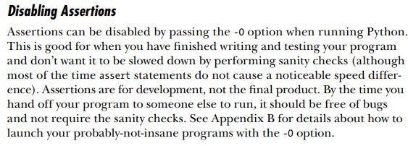

Slide 13
Logging
If a print() statement is used in the code to output some variable’s value while the program is running, it is a form of logging to debug the code.
Logging is a means of tracking events that happen when some software runs.
The programmer adds logging calls to the code to indicate that certain events have occurred and is described by a descriptive message which can optionally contain variable data (i.e. data that is potentially different for each occurrence of the event)..
Python’s logging module makes it easy to create a record of custom messages that are written.
These log messages describe when the program execution has reached the logging function call and list any variables that specified at that point in time.
On the other hand, a missing log message indicates a part of the code was skipped and never executed.

Slide 14
Using the logging Module
To enable the logging module to display log messages on screen as the program runs copy the following to the top of the program
import logging logging.basicConfig(level=logging.DEBUG, format=‘ %(asctime)s - %(levelname)s - %(message)s')
when Python logs an event, it creates a LogRecord object that holds information about that event.
The logging module’s basicConfig() function specifies the details of LogRecord object needed and how those details have to be displayed.
Logging provides a set of convenience functions for simple logging usage.
These are debug(), info(), warning(), error() and critical()
Logging is a way to store information about your script and track events that occur.

Slide 15
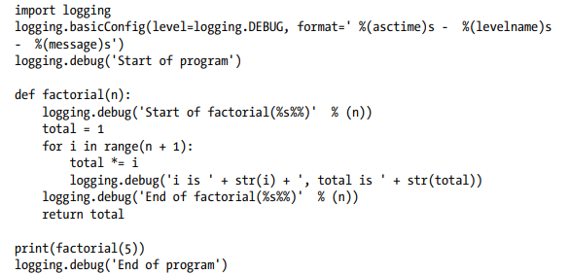
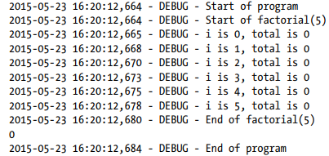

Slide 16
Logging Functions
DEBUG - logging.debug() The lowest level. Used for small details.
INFO - logging.info() Used to record information on general
WARNING - logging.warning() Used to indicate a potential problem that doesn’t prevent the program from working but might do so in the future.
ERROR - logging.error() Used to record an error that caused the program to fail to do something.
CRITICAL - logging.critical() The highest level. Used to indicate a fatal error that has caused or is about to cause the program to stop running entirely.

Slide 17
How To Set Up Basic Logging Configuration
lo
Step 1: Import the logging module – import logging
Step 2: Configure the logging level -logging.basicConfig(level=logging.INFO)
To set the minimum logging level for the program, use the basicConfig() function
The levels are : DEBUG, INFO, WARNING, ERROR, CRITICAL
Step 3: Log messages
Use the logging functions to record messages at different severity levels
The five main logging functions correspond to the five levels mentioned above:
logging.debug()
logging.info()
logging.warning()
logging.error()
logging.critical()

Slide 18
Log Record Attributes
Each log message in Python is represented by a LogRecord object, which contains various attributes related to the log event.
Some commonly used attributes are:
levelname: The textual representation of the log level (e.g., ‘DEBUG’, ‘INFO’, ‘WARNING’, etc.).
asctime: The time the log event was created, as a string.
message: The log message text.
filename: The name of the file where the log call was made.
lineno: The line number in the file where the log call was made.
funcName: The name of the function where the log call was made.
A full list of LogRecord attributes can be found in the Python logging documentation.

